Slide 1
Adaptïve guïz
and Test Engïne
S T U DE N T S
FAC U L T Y G UI D E
N.SHAMBU PRASAD GOUD (2620080119)
Gopi Krishna Sir
B.SRIKAR (2620030677)

Slide 2

01. INTRODU CTI ON
Dgnamic Assessment
Real-time difficulty adjustment. Precision skill evaluation.

Slide 3
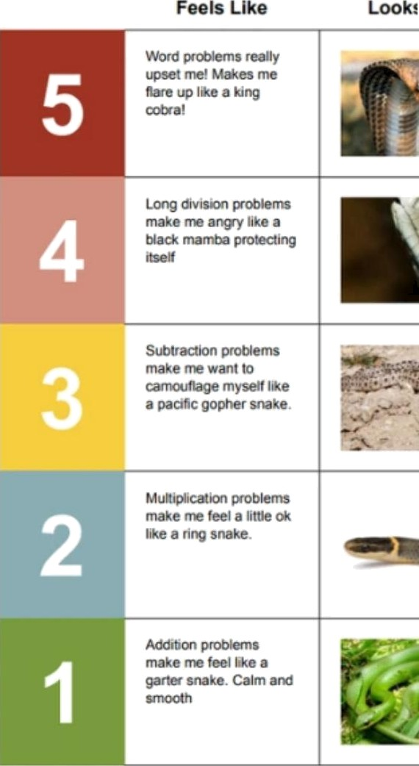
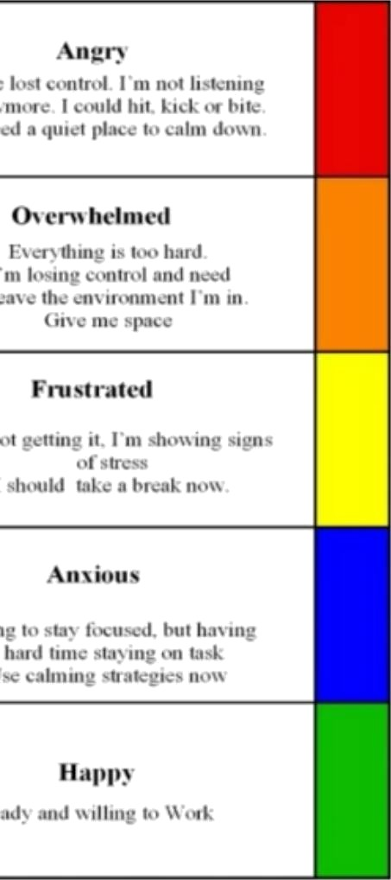
I Scale for Anger
Example 5-Point Scale for I"1‹
O 2. PR OBLE M STAT EM ENT
Static tests fail to measure true capabilitg.
Fixed difficulty frustrates beginners and bores advanced learners.
One-size-fits-all logic ignores individual learning curves.
t Scale for anger Empowerment see
!s for link)
Example 5-Point Scale for m personalised to an individual pupil's (Source: OCALI see refer

Slide 4

03. OBJECTIVES
S9stem Goals
@
Tailored Assessment
Individual skill mapping.
r.
MaWmumEnqagement
Optimal challenge Ie vels.
Instant Analytics
Real-time performance insights.

Slide 5

Current Limitations
0 4. EXI STING SYSTEM
X Static Question Banks
X
Universal Diff1cultg Scaling
X
No Personalized Feedback
X Manual, Delayed Grading

Slide 6
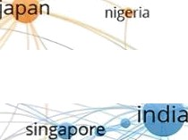


Intelligent Architecture
05. PROPOSED SYSTEM
indonesia
Dynamic Difficulty Adjustment
Questions scale based on live performance.
netherlands
germany ' !’
'°•""
Item Response Theorg
Advanced algorithmic question selection.
Actionable Metrics
Deep analytics for continuous skill tracking.
VOSviewer

Slide 7



Three-Tier Model
Client Lager
Logic Lager
Data Lager
React UI Application
Spring Boot API
MySQL Repository

Slide 8
Gore Features
07. FUNCTIONALITIES
Role-Based Access
Secure portals for Admins, Faculty, and Students.
Smart Repositories
Metadata-tagged banks organized by micro-
Live Adaptive Engine
Instant recalibration of test difficulty on-the-fly.
Predictive Analytics
l Visual reporting to identify knowledge gaps rapidly.

Slide 9
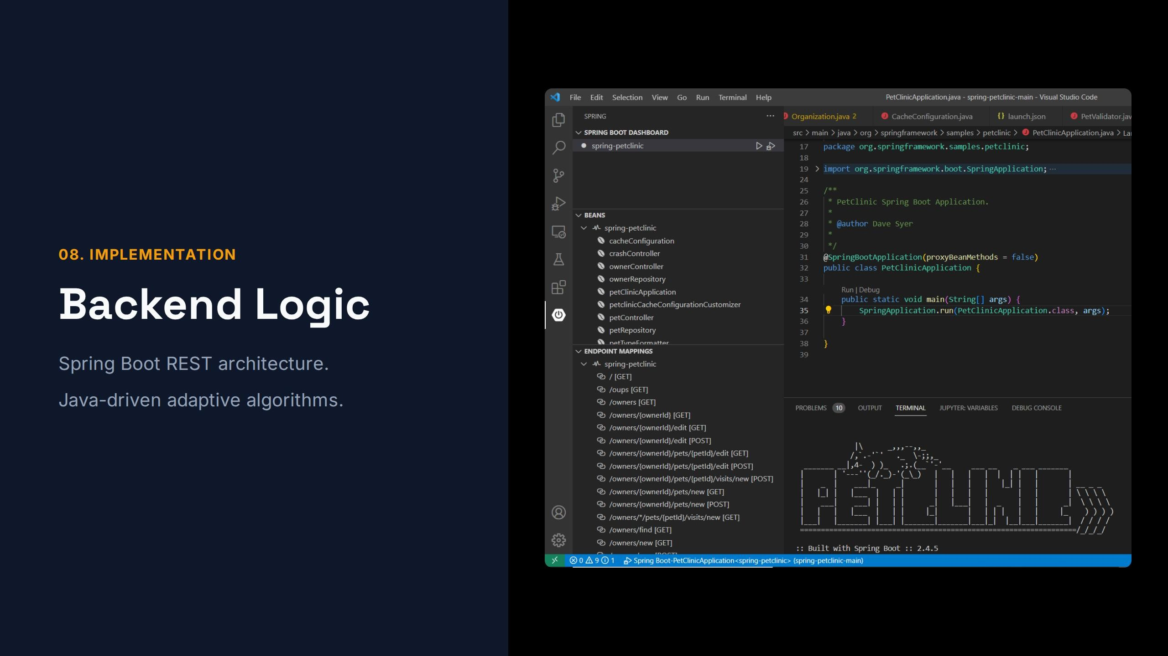

Slide 10
Live Dashboards
09. OUTPUT
Real-time analytical insights.

Slide 11
Next Iterations
10. FUTURE SCOPE
AI Content Generation
Predictive Paths
Advanced Proctoring
Automated question creation using
LLMs.
Custom study recommendations.
Vision-based integrity monitoring.

Slide 12
Transforming static assessment
into an intelligent, personalized learning journeg.
Adaptive testing guarantees precise skill evaluation, maximizes engagement, and accelerates educational outcomes.

Slide 13
12. TH AN K YO U
guestions & Answers
We are open for any queries regarding the adaptive engine.

Slide 14






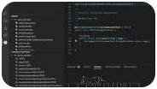
Image Sources
https://www.lovemytest.com/images/howit4a.jpg
Source: www.lovemytest.com
https://reaItraining.co.uk/wp/wp—content/uploads/2025/01/Incredible—5—Point—Scale—Examples—1.webp
Source: realtraining.co.uk
-. ¿
https://cdn.arabsstock.com/uploads/images/367687/thumbnail/1759658704tepsfjrh2a—17596587315zuh1.webp
Source: arabsstock.com
https://f1000research-files.f1000.com/manuscripts/202518/0bb4e00d—fffd—4b79—9c92-d0c85c10e46b_figure1.gif
Source: f1000research.com
https://devbIogs.microsoft.com/java/wp—content/uploads/sites/51/2022/06/springbootdashboard—1.png
Source: devblogs.microsoft.com
“ “
https://cdn.dribbbIe.com/userupIoad/42039150/file/original—468e3fd9c25acd7f1cc53940133f51f5.jpg?resize=400•300
Source: dribbbIe.com

